Slide 1
Super Model of the World and Ames, Iowa
by Evan Jacobs, Undisputed Kaggle Champion

Slide 2
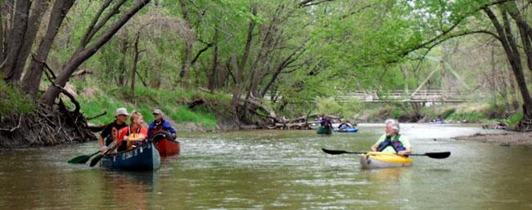
Call Me By Your Ames
Ames Iowa is a beautiful city and has consistently ranked in the top ten in the Quaintness Index. Therefore, we should make money there. BUT CAN WE?
The Skunk River: Home to paddling old people and probably skunks.

Slide 3
Dirty, Dirty Data
The data from the Ames was so dirty it had stink lines coming off of it. Here’s what I did to clean it.
Filled all the null values of numerical columns with the mean of that column.
Filled all the null values in the object columns with a big, fat zero. The zero columns won’t hurt anybody and will get dropped in the selection process.
Checked for outliers but stopped as
dropping rows would have made my model incompatible with the test set and
I’m not even sure I believe in the concept of outliers. I will not discriminate against data. I am not a datist.

Slide 4
And Now, the Feature Presentation
I thought very hard about how to select features. And by very hard, I mean I let the computer do it.
Separated object and numerical columns
Got dummies on the object columns for models where I used them
Used a cute little command to return all columns correlating with target data greater than a number of my choosing
Lots of the columns were similar, having to do with square footage or garage size, so for my first two models, I used polynomial features

Slide 5
MODELS MODELS MODELS
This is the part where I confidently and expertly apply concepts I learned 48 hours before.
Model 1: Just the numerical data with polynomial features
Model 2: Numerical and categorical with polynomial features
Model 3: Linear regressions with no interaction terms.

Slide 6
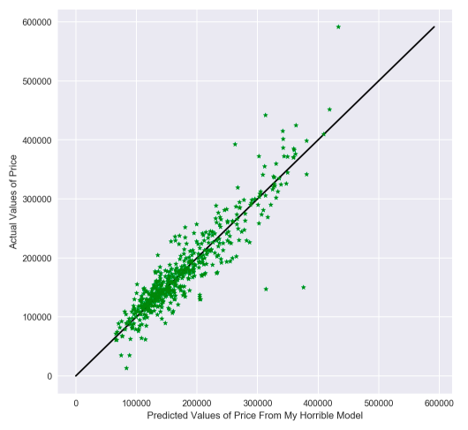
Model 1: My Firstborn
For model 1, which contained only numerical data, as my sensitivity to correlation went up, my lasso score went down, but my ridge score and electric net score went up.
I then tried keeping a high correlation and increasing the degree of my polynomial.
Eventually, with enough tweaking, I was able to keep it worse than my first attempt.

Slide 7
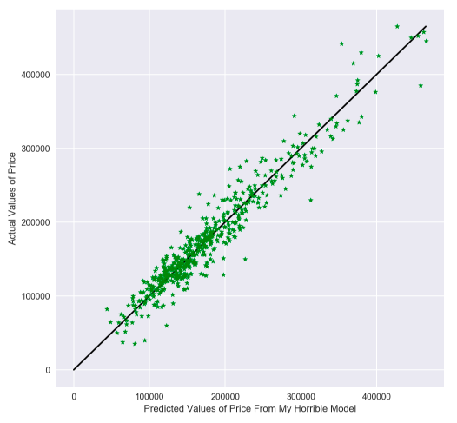
Model 2: The Middle Child
Model 2 had my dummy data. I wasn’t very lucky with the extra variables though. Most of the extra 200 had weak correlations, except for about 2.
Here I maxed out with an R2 of about .89.
Just looking at the graph you can see this probably had the capacity to be my strongest model, if I knew how to tweak it.

Slide 8
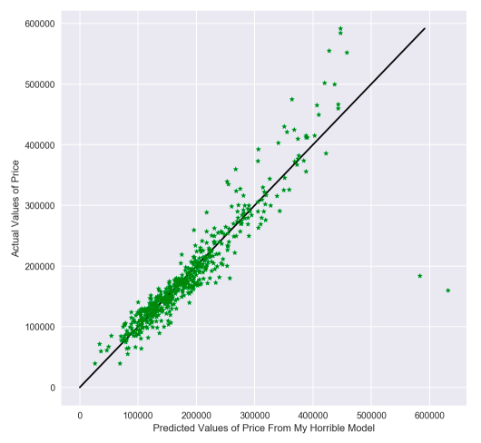
Model 3: The One Who Means Well
Just for kicks, I experimented with using no interaction terms and just doing a simple linear model based on all the numerical and dummy columns past a certain threshold of correlation I set.
As you can see, it does a fairly good job, but clearly the data wants to curve upwards, meaning that that fitting a polynomial curve to it might be better.

Slide 9
So What? And Now What?
Important takeaways:
Ames is the home of the Skunk River
The data most likely has a curve to it best fitted by a polynomial function
The numerical columns alone gave a poorer fit than all the columns
Even the linear model is enough to move to Ames and start flipping
What could make our model better?
Knowing more about data science
Not being sleep deprived
Having more time to tweak models

Slide 10
THANK YOU
You may now ask me softball questions

